Slide 1
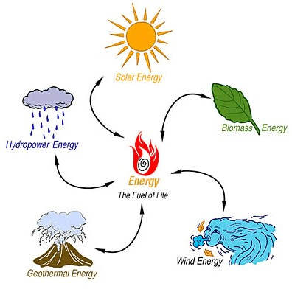
Energy

Slide 2

What is Energy?
Energy (E) is defined as:
The ability to do work
But what does that MEAN???
Notes:
Where 1 joule is the amount of work done by 1 force being applied through 1 m in the same direction of the force

Slide 3
What is money?
Similar to money, energy can be thought of as “the currency of the universe”
W = ∆E
Energy: is a scalar quantity
can be positive or negative
is measured in joules
Notes:
This is one of the most valuable formulas we will learn this unit

Slide 4



Mechanical Energy
Is a combination of:
Kinetic Energy:
energy due to motion
and Gravitational Potential Energy:
energy due to height
Notes:
However, many objects will have an energy associated with them already

Slide 5

Calculating Kinetic Energy
We can calculate the kinetic energy of an object using:
Where E_{k} is the kinetic energy [J]
m is the mass [kg]
v is the speed [m/s]
Notes:
Energy is proportional to mass
Energy is proportional to the square of the speed
See derivation on p. 230

Slide 6
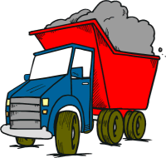
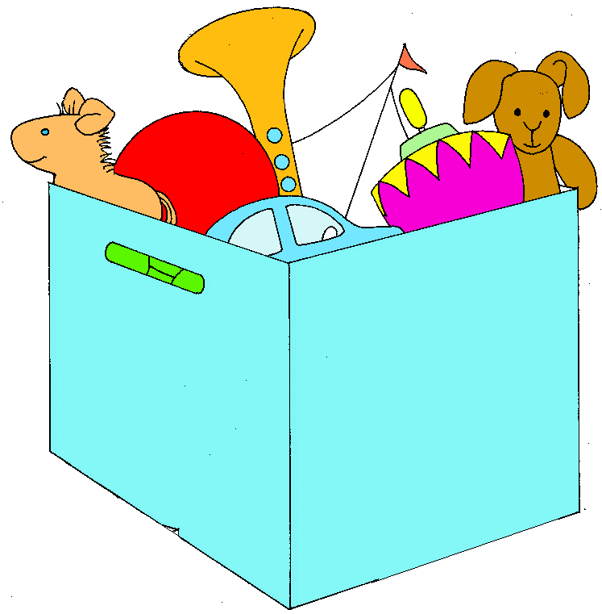
Examples
A 5000 kg truck moves along at 15 m/s. What is its kinetic energy?
2. A 6.0x10¹ g toy has 18.8 J of kinetic energy. What is its speed?

Slide 7

With a Partner…
A force of 5.0x10¹ N is applied to an object with a mass of 2.0 kg for a distance of 2.0 m. If it is initially at rest, what is its change in kinetic energy?
There are TWO DIFFERENT WAYS to solve this problem. Can you figure them both out?

Slide 8
Calculating Gravitational Potential Energy
Gravitational Potential Energy is calculated with respect to a specific reference level.
Above Reference Level
E_{g} > 0 J
Reference Level
E_{g} = 0 J
Below Reference Level
E_{g} < 0 J

Slide 9
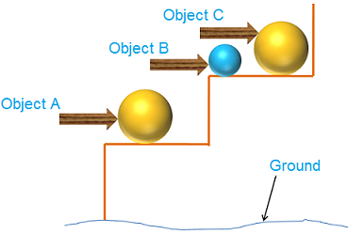
Calculating Gravitational Potential Energy
We can calculate the gravitational potential energy of an object using:
Where E_{g} is gravitational potential energy [J]
m is mass [kg]
g is gravitational field strength (or acceleration due to gravity)
h is height above (h>0) or below (h<0) reference [m]

Slide 10
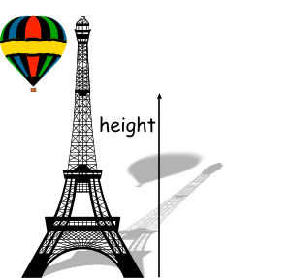
Important Rules About E_{g}
h is the vertical position (with respect to a reference level). It is independent of the path taken!
We assume h is small enough that g is constant
It is usually best to keep your reference point CONSTANT throughout a problem

Slide 11


Example
A 1.0 kg coconut is perched atop the roof of a 4.0 m tall house which is on a cliff 30.0 m high.
What is the gravitational potential energy relative to the top of the cliff?
What is the gravitational potential energy relative to the water?
4.0 m
Notes:
Ans: a) 39 J b) 3.3x10² J

Slide 12
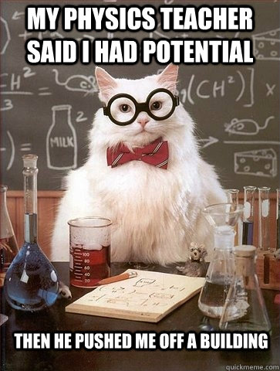
SHE

